Slide 1
Content
SAP Overview
ABAP Dictionary/ Data Dictionary
ABAP Basics
Reports
Module Pool Programming
Layout Sets
Data Conversions
Modification and Enhancements
Connectivity
Notes:
First Slide

Slide 2
ABAP Basics Content
Types of Programs
ABAP Editor & Functionalities
WRITE Statement
Datatypes & Variables
Internal Tables
Operators
Control Structures
Open SQL
Modularization Techniques
Debugging Basics
Messages
Authorization Checks

Slide 3
ABAP Basics
Type of Programs
ABAP Basics
Executable Programs also called Report Programs: Type: 1
Features:
we can directly execute in SE38 transaction.
No transaction code needs to be created for this Executable programs
It contains limited number of screens. Mostly from 1 to 2 screens including
Selection screen
Example: MMBE, MB51, ME2M ets.
Transaction used to create Report Programs
SE38 – ABAP Editor
SE41 – GUI status ( Menu Bar, Standard Tool Bar & Application Tool Bar)
SE93 – Create transaction Code (Optional)
Naming Convention: R*
Types of Programs:
Report Program
ABAP Editor & Basic Terminology
Data Type & Variables
Internal Tables
Operators
Control Structures
Open SQL
Modularization Techniques
Messages
Authorization Checks

Slide 4
ABAP Basics
Type of Programs
ABAP Basics
Module pool Programs: Also called dialog programs or transaction programs. Type – M
Features:
Non executable programs
Transaction code is required to run Module pool programs
These program may contains may screens
Example: ME21N, VA01, VL0, MIGO etc.
Transaction used to create Module Pool Programs
SE38 – ABAP Editor
SE51 – Screen Painter to design the screens
SE41 – GUI status ( Menu Bar, Standard Tool Bar & Application Tool Bar)
SE93 – Create Transaction code
OR
SE80 - Object Navigator
Naming Convention: SAPM*
Types of Programs: Module pool Programs
ABAP Editor & Basic Terminology
Data Type & Variables
Internal Tables
Operators
Control Structures
Open SQL
Modularization Techniques
Messages
Authorization Checks

Slide 5
ABAP Basics
Type of Programs
ABAP Basics
Include Programs: Type – I
Features:
Include programs are not executable programs
Include programs are used for modularization purpose
We will create Include programs for Readability and Reusability purpose
Transaction used to create Include Programs
SE38 – ABAP Editor
We can call the Include program in other Program using INCLUDE
Statement
INCLUDE <include_program_name>
Types of Programs: Include Program
ABAP Editor & Basic Terminology
Data Type & Variables
Internal Tables
Operators
Control Structures
Open SQL
Modularization Techniques
Messages
Authorization Checks

Slide 6
ABAP Basics
Type of Programs
ABAP Basics
Function Group: Type – F
Features:
It is a complex program to hold logically related function module
Every function module should be part of one function group
Function Group and Function Modules are not executable programs
Function Modules created for Reusability purpose
Transaction used to create Function Module or Function Group
SE37 – Function Builder Or
SE80 – Object Navigator
We can call the Function Module in other Program using CALL FUNCTION
Statement
CALL FUNCTION <function_module_name>
<Parameters>
Types of Programs: Function Group
ABAP Editor & Basic Terminology
Data Type & Variables
Internal Tables
Operators
Control Structures
Open SQL
Modularization Techniques
Messages
Authorization Checks

Slide 7
ABAP Basics
Type of Programs
ABAP Basics
There are few other types of Programs which help us in developments
Subroutine Pool:
Class Pool
Interface Pool
Type Pool
Types of Programs: Other Program Types
ABAP Editor & Basic Terminology
Data Type & Variables
Internal Tables
Operators
Control Structures
Open SQL
Modularization Techniques
Messages
Authorization Checks

Slide 8


ABAP Basics
ABAP Basics
It is time to enter the Programming world #$*^%!@ #$*^%!@ #$*^%!
Types of Programs: Other Program Types
ABAP Editor & Basic Terminology
Data Type & Variables
Internal Tables
Operators
ABAP !!!!!!!
Control Structures
Open SQL
Modularization Techniques
Messages
Authorization Checks

Slide 9
ABAP Basics
Types of Statements
ABAP Basics
Types of Programs: Other Program Types
Types of Statements
Keywords
Executable Statements
Data types and Variables
Expressions
Symbols:
Period – Statement Terminator
Colon – Chain Operator
Comma – Statement Separator
Asterisk and Double Quotes – Comments
Single Quote – Literals
ABAP Editor & Basic Terminology
Data Type & Variables
Internal Tables
Operators
Control Structures
Open SQL
Modularization Techniques
Messages
Authorization Checks

Slide 10
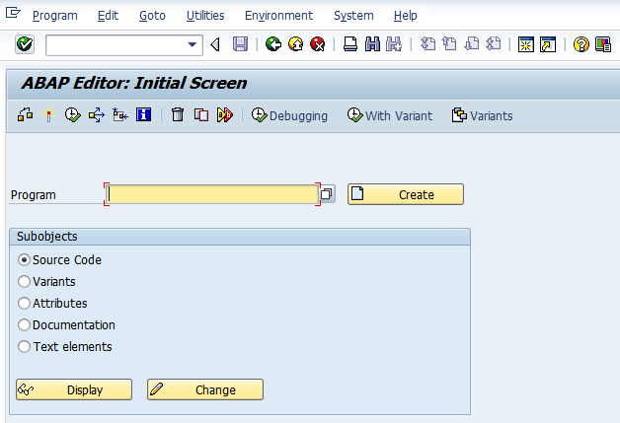
ABAP Basics
ABAP Editor
Menu Bar
Title Bar
Standard Tool Bar
Application Tool Bar
Sub Objects:
Source Code: Editor for coding
Variants: Selection Screen Variants
Attributes:
To display Packages, Create/Change date and User IDs etc
4. Documentation:
5. Text Elements used in the Program
Program Name

Slide 11
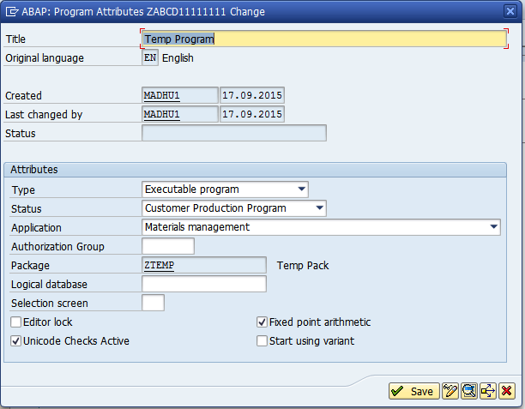
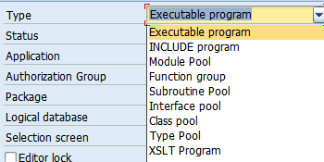
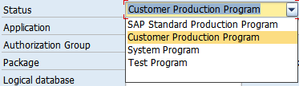
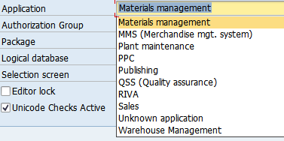
ABAP Basics
ABAP Editor
Short Description

Slide 12
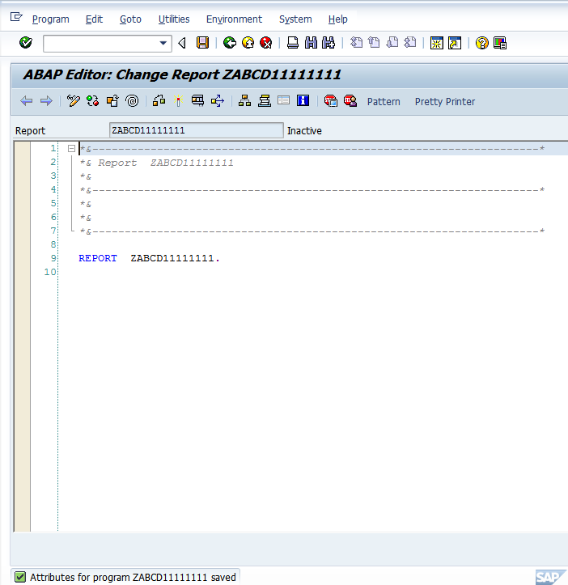
ABAP Basics
ABAP Editor
Report Header: Specify details about the program
REPORT Keyword and Report Name
ABAP Work area
Status Bar

Slide 13
ABAP Basics
ABAP Editor
ABAP Basics
List of activities
Write the Logic
Save the Program by clicking SAVE button on Standard too Bar or Pressing Ctrl + S
Check the Syntax By Clicking Button on Application Tool Bar or Pressing Ctrl +F2
Once Program is syntactically correct then Activate by clicking on Button on Application tool bar or Pressing Ctrl + F3
Once Program activated then you can test the program by clicking on Button or Pressing F8
Types of Programs: Other Program Types
ABAP Editor & Basic Terminology
Data Type & Variables
Internal Tables
Operators
Control Structures
Open SQL
Modularization Techniques
Messages
Authorization Checks

Slide 14
ABAP Basics
WRITE Statement
ABAP Basics
WRITE statement is used to print static text or content of variable on screen.
It can also be used to copy the content of one variable to another variable.
Additions:
/ - Newline Character. It will display text on next line
: and , – Chain and Statement Separator
Output Columns and Size specification
Types of Programs: Other Program Types
ABAP Editor & Basic Terminology
Data Type & Variables
Internal Tables
Operators
WRITE 'SAP ABAP Demo',.
WRITE 'Welcome to ABAP'.
Output will be printed on single line
WRITE 'SAP ABAP Demo',.
WRITE / 'Welcome to ABAP'.
Output will be printed on different lines
WRITE: 'SAP ABAP Demo', / 'Welcome to ABAP'.
Output printed on different lines.
WRITE: 5 'SAP ABAP Demo', /5(10) 'Welcome to ABAP'.
Both lines printed from 5th column and second line contains only 10 characters. Remaining characters will be truncated on output.
Control Structures
Open SQL
Modularization Techniques
Messages
Authorization Checks

Slide 15
ABAP Basics
Data Type
ABAP Basics
Data Types:
It defines technical attributes of data in the runtime. Based on its usage we can classify into following types
1. Elementary
2. Structured (Multi elementary types)
3. Table types (Multi line structured types)
Elementary data type nothing but simple datatypes, which are used to define variables
Structured data types are composed of several simple data types or other structure data types.
Table types are composed of structure.
Types of Programs
ABAP Editor & Basic Terminology
Data Type & Variables
Internal Tables
Operators
Control Structures
Open SQL
Modularization Techniques
Messages
Authorization Checks

Slide 16
ABAP Basics
Data Type
ABAP Basics
Built in Data Types:
SAP has provide some set of data types called Built in Data Types
Types of Programs
Data Type | Length | Standard Length | Description
B | 1 Byte |  | 1 Byte Integer
C | 1 to 65,535 Characters | 1 Character | Text Field
Cursor | As I | As I | Database Cursor
D | 8 Characters |  | Date Field
F | 8 Bytes |  | Floating Point Number
I | 4 Bytes |  | 4 Byte Integer
N | 1 to 65,535 Characters | 1 Character | Numeric Text
P | 1 to 16 Bytes | 8 Bytes | Packed Number
String | Variable |  | Text String
S | 2 Bytes |  | 2 Bytes Integer
T | 6 Characters |  | Time Field
X | 1 to 65,535 Bytes | 1 Byte | Byte Field
Xstring | variable |  | Byte String
ABAP Editor & Basic Terminology
Data Type & Variables
Internal Tables
Operators
Control Structures
Open SQL
Modularization Techniques
Messages
Authorization Checks

Slide 17
ABAP Basics
Data Type
ABAP Basics
Apart from Built in types there are other data types as well
Data Dictionary – Data Elements, Structures and Table Types
Type Group/Type Pools
With in ABAP Programs/Subroutines/Function Modules – User Defined Data types. User defined types declared with help of TYPES statement
Types of Programs
ABAP Editor & Basic Terminology
Data Type & Variables
Internal Tables
Variables: Variables are declared with statement ‘DATA’
Syntax:
DATA <variable_name>(size) TYPE [TABLE OF] <data_type> [additions]
Declare variables Using Built in Types
Example:
DATA Empid(5) TYPE n.
DATA Empname(20) TYPE c.
DATA Empsal TYPE p DECIMALS 2.
Using Data Elements as Data type
DATA l_matnr TYPE matnr.
DATA l_ebeln TYPE ebeln.
DATA l_aufnr TYPE aufnr.
Operators
Control Structures
Open SQL
Modularization Techniques
Messages
Authorization Checks

Slide 18
ABAP Basics
Data Type
ABAP Basics
User Defined Types:
We can declare our own data types using TYPES statements
TYPES t_name TYPE c LENGTH 20.
Declare variable with user defined data type
DATA l_ename TYPE t_name.
Structure Type/work area type:
Collection of fields is called structure or work area or field string
We can use table in the dictionary to declare work area
We can use structures in the dictionary to declare work area
We can create our own structure type to locally to create work area called user defined structure type
We can declare work area using DDIC table
DATA wa_mara TYPE mara.
DATA wa_ekko TYPE ekko
Types of Programs
ABAP Editor & Basic Terminology
Data Type & Variables
Internal Tables
Operators
Control Structures
Open SQL
Modularization Techniques
Messages
Authorization Checks

Slide 19
ABAP Basics
Structure/work area
ABAP Basics
Syntax: to declare work area type/ structure type locally
TYPES : BEGIN OF <struct_type>,
<field_1> TYPE <type_1>,
<field_2> TYPE <type_2>,
<field_n> TYPE <type_n>,
END OF <struct_type>
Example:
Data wa_mara TYPE mara. “Declare work are with respect to Ddic table
“Declare work type later declare work area
TYPES:
BEGIN OF ty_emp,
num TYPE i,
name(10) TYPE c,
addr(100) TYPE c,
END OF ty_emp.
DATA: wa_emp1 TYPE ty_emp,
Types of Programs
ABAP Editor & Basic Terminology
Data Type & Variables
Internal Tables
Operators
Control Structures
Open SQL
Modularization Techniques
Declare work area directly using DATA statement
DATA
BEGIN OF wa_emp,
num TYPE i,
name(10) TYPE c,
addr(100) TYPE c,
END OF wa_emp.
Messages
Authorization Checks

Slide 20
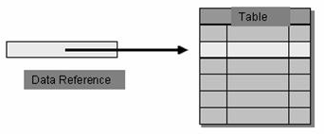
ABAP Basics
Internal Tables
ABAP Basics
Internal tables are multi line structured types/objects. We can store several lines of similar structured data in an internal table.
While defining internal table, we can specify some characteristics, so that it behaves in that way.
we can specify key (Unique/Non Unique) for internal table.
We can declare internal table by referring ABAP dictionary structure, Local structure or type pool structures.
Types of internal tables:
1 Standard - Most frequently use
2 Sorted - data will be stored in sorted order so no need to sort again
3 Hashed - Generally internal use
Types of Programs
ABAP Editor & Basic Terminology
Data Type & Variables
Internal Tables
Operators
Control Structures
Open SQL
Modularization Techniques
Messages
Authorization Checks

Slide 21
ABAP Basics
Internal Tables
ABAP Basics
Operations on Internal tables
1. Declaring Internal table
2. Filling
a. Append/ Append lines of
b. Insert / Insert lines of
c. Collect
3. Retrieving
a. Loop - loop through entire internal table record by record
b. Read - search internal table
4 Delete
a. clear/refresh - delete all records without specifying any condition
b. delete - delete records based on condition
5. Sort - sort internal table
6. Describe – count number of lines in internal table
7. Clearing Internal table
8. Copying
Types of Programs
ABAP Editor & Basic Terminology
Data Type & Variables
Internal Tables
Operators
Control Structures
Open SQL
Modularization Techniques
Messages
Authorization Checks

Slide 22
ABAP Basics
Internal Tables
Declaring Internal Table
Declare Internal table with ref to DDIC table/structure
DATA: it_mara TYPE TABLE OF mara.
2. Declare internal table with local work area type
TYPES:
BEGIN OF ty_mara,
matnr TYPE matnr,
mtart TYPE mtart,
mbrsh TYPE mbrsh,
END OF ty_mara
DATA: it_mara TYPE TABLE OF ty_mara
3. Declare internal table based on local table type
TYPES: ty_mara_tab TYPE TABLE OF ty_mara.
DATA it_mara TYPE ty_mara_tab.
4. Internal table with Header line (Obsolete)
DATA: BEGIN OF it_mara,
matnr TYPE matnr,
mtart TYPE mtart,
mbrsh TYPE mbrsh,
END OF it_mara OCCURS 0. OR
DATA it_mara TYPE TABLE OF wa_mara WITH HEADER LINE
ABAP Basics
Types of Programs
ABAP Editor & Basic Terminology
Data Type & Variables
Internal Tables
Operators
Control Structures
Open SQL
Modularization Techniques
Messages
Authorization Checks

Slide 23
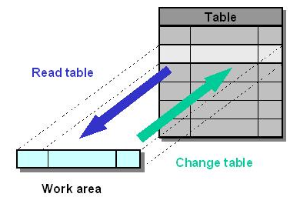
ABAP Basics
Internal Tables
Work Area:
To process records on Internal table WORK AREA is required .
1. Adding Records
2. Modifying Records
3. Reading Records
ABAP Basics
Types of Programs
ABAP Editor & Basic Terminology
Data Type & Variables
Internal Tables
Operators
Control Structures
Open SQL
Modularization Techniques
Messages
Authorization Checks

Slide 24
ABAP Basics
Internal Tables
Appending Records to Internal Table
APPEND is the keyword to add record to the internal table
Example:
“Fill Work area
Wa_mara-matnr = ‘M1’.
Wa_mara-mtart = ‘HALB’.
Wa_mara-mbrsh = ‘AB’.
“Append work area to Internal Table
APPEND wa_mara To it_mara.
“Fill Work area
Wa_mara-matnr = ‘M2’.
Wa_mara-mtart = ‘FERT’.
Wa_mara-mbrsh = ‘AB’.
“Append work area to Internal Table
APPEND wa_mara To it_mara.
ABAP Basics
Types of Programs
ABAP Editor & Basic Terminology
Data Type & Variables
Internal Tables
Operators
Control Structures
Open SQL
Modularization Techniques
Messages
Authorization Checks

Slide 25
ABAP Basics
Internal Tables
Reading Record by record in the Internal Table
Syntax:
LOOP AT <itab> INTO <wa>
ENDLOOP
Example:
Loop at it_mara into wa_mara.
Write: / sy-tabix
wa_mara-matnr,
wa_mara-mtart,
wa_mara-matkl.
Endloop.
System Variable: SY-TABIX will contains current loop index
Reading Single Record:
Using Key
READ TABLE <itab> INTO <wa> WITH KEY matnr = ‘M1’
Using Index
READ TABLE <itab> INTO <wa> INDEX 1
System Variable SY-SUBRC contain 0 if matching record found
ABAP Basics
Types of Programs
ABAP Editor & Basic Terminology
Data Type & Variables
Internal Tables
Operators
Control Structures
Open SQL
Modularization Techniques
Messages
Authorization Checks

Slide 26
ABAP Basics
Internal Tables
Sorting:
This command will sort the internal table by rearranging the records based on fields specified in the command
SORT <itab> BY [<f1> <f2>..<fn> ASCENDING/DESCENDING]
By default it will sort in ASCENDING ORDER
Describe
This command is to find the number records in the internal table
DESCRIBE TABLE <itab> LINES <lines>.
Clearing Internal Table:
CLEAR/REFRESH: It is used to clear entire internal table with out any condition
CLEAR <itab>
REFRESH <itab>
DELETE is used to delete the records based on Condition
DELETE <itab> WHERE <condition>
Copying Internal Table
Example: <itab2> = <itab1>
MOVE <itab1> TO <itab2>
ABAP Basics
Types of Programs
ABAP Editor & Basic Terminology
Data Type & Variables
Internal Tables
Operators
Control Structures
Open SQL
Modularization Techniques
Messages
Authorization Checks

Slide 27
ABAP Basics
Internal Tables
Sorted Internal Tables
When Declaring internal table with following specification “TYPE TABLE OF”
Then it is STANDARD internal table. Till now we performed operations on STANDARD internal table
Declaring Sorted Internal Table
DATA <itab> TYPE SORTED TABLE OF <type> WITH KEY <f1> <f2>…
Inserting Records to the Sorted Internal Table
INSERT <wa> INTO <itab> INDEX <index>
Notes:
Records should be inserted in the sorted order only
No need to use any SORT command
Sorted Internal table allow to maintain records in sorted order always
Generally we will not use HASHED internal tables
ABAP Basics
Types of Programs
ABAP Editor & Basic Terminology
Data Type & Variables
Internal Tables
Operators
Control Structures
Open SQL
Modularization Techniques
Messages
Authorization Checks

Slide 28
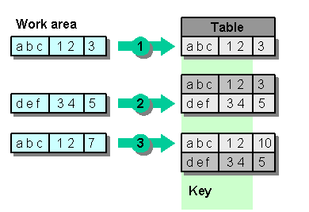
ABAP Basics
Internal Tables
Collecting Entries
COLLECT statement summate entries in the internal table
Syntax:
COLLECT <wa> INTO <itab>
Example:
ABAP Basics
Types of Programs
ABAP Editor & Basic Terminology
Data Type & Variables
Internal Tables
Operators
Control Structures
Open SQL
Modularization Techniques
Messages
Authorization Checks

Slide 29
ABAP Basics
Internal Tables
ABAP Basics
Loop Control Break Statements
AT FRIST..ENDAT: It will be called only one time at the time of looping first record
AT LAST..ENDAT: it will be called only one time at the time of looping last record
AT NEW <field>..ENDAT: it will be called every new value of the filed
AT END OF <field>..ENDAT: it will be called every last values of the field
SUM is the keyword to sum up the numerical values in side the above Loop control break statements
We can use the above specified blocks inside the LOOP..ENDLOOP
Types of Programs
ABAP Editor & Basic Terminology
Data Type & Variables
Internal Tables
Operators
Control Structures
Open SQL
Modularization Techniques
Messages
Authorization Checks

Slide 30
ABAP Basics
Internal Tables
ABAP Basics
MATNR | WERKS | LGORT | LABST
M1 | P1 | S1 | 10
M1 | P1 | S2 | 10
M1 | P2 | S3 | 10
M1 | P2 | S4 | 10
M1 | P2 | S5 | 10
M1 | P2 | S6 | 10
Types of Programs
ABAP Editor & Basic Terminology
Data Type & Variables
Internal Tables
Operators
LOOP AT it_mara INTO wa_mara.
AT FIRST.
WRITE ‘Material’, ‘Plant’,’Sloc’, ‘Stock’.
ENDAT.
AT NEW OF werk.
ENDAT.
Write: wa_mara-matnr, wa_mara-werks, wa_mara-lgort,wa_mara-labst
AT END OF werks
SUM.
Write: ‘Total Stock of the Material in the Plant ’, wa_mara-werks, wa_mara-labst.
ENDAT.
AT LAST.
ENDAT.
ENDLOOP
Control Structures
Open SQL
Modularization Techniques
Messages
Authorization Checks

Slide 31
ABAP Basics
Operators
ABAP Basics
Operators are symbols used to build logical expressions
Types of Operators
Assignment Operators
MOVE source TO destination
destination = source
Resetting variable to the Initial value
CLEAR <variable>
Arithmetical Operators
Types of Programs
ABAP Editor & Basic Terminology
Data Type & Variables
Internal Tables
Operators
Control Structures
Operator | Meaning
+ | Addition
‑ | Subtraction
* | Multiplication
/ | Division
DIV | Integer division
MOD | Remainder of integer division
‑** | Powers
Open SQL
Modularization Techniques
Messages
Authorization Checks

Slide 32
ABAP Basics
Operators
ABAP Basics
Relational operators
Types of Programs
ABAP Editor & Basic Terminology
Operator | Description
=, EQ | Equal: True, if the content of operand1 matches the content of operand2.
<>, NE | Not Equal: True, if the content of operand1 does not match the content of operand2.
<, LT | Lower Than: True, if the content of operand1 is smaller than the content of operand2.
>, GT | Greater Than: True, if the content of operand1 is greater than the content of operand2.
<=, LE | Lower Equal: True, if the content of operand1 is lower than or equal to the content of operand2.
>=, GE | Greater Equal: True, if the content of operand1 is greater than or equal to the content of operand2
Data Type & Variables
Internal Tables
Operators
Control Structures
Open SQL
Modularization Techniques
Messages
Authorization Checks

Slide 33
ABAP Basics
Operators
ABAP Basics
Relational operators
Between:
A logical expression with the language element BETWEEN checks where an interval belongs
Syntax: operand [NOT] BETWEEN operand1 AND operand2 ...
IS- Logical expressions with the language element IS check the state of an operand.
IN- In a logical expression with language element IN, the conditions of a selection table are checked.
AND, OR, NOT
The Boolean operators AND & OR link, in each case, multiple logical expression, while the operator NOT negates a logical expression. Logical expressions can be explicitly bracketed with ( ).
Note: example will be available in further sections
Types of Programs
ABAP Editor & Basic Terminology
Data Type & Variables
Internal Tables
Operators
Control Structures
Open SQL
Modularization Techniques
Messages
Authorization Checks

Slide 34
ABAP Basics
Control Structure
ABAP Basics
Control Structures: these are used to alter the flow of program execution.
Program can contains several executable statements.
But based values in the Program, some statements have to be executed.
This can be achieved using Control structures
Following are the control structures
1. Branching;
these are used to either execute or skip the block of statements
Based on condition/expression
2. Looping
these are used to execute the block of statements repeatedly
Types of Programs
ABAP Editor & Basic Terminology
Data Type & Variables
Internal Tables
Operators
Control Structures
Open SQL
Modularization Techniques
Messages
Authorization Checks

Slide 35
ABAP Basics
Control Structure
ABAP Basics
Branching: IF..ELSEIF..ELSE
It will executed the block of statements based on the result of logical
Expression
It is condition based
Syntax:
IF log_exp1. [statement_block1] [ELSEIF log_exp2. [statement_block2]] ... [ELSE. [statement_blockn]] ENDIF.
Types of Programs
ABAP Editor & Basic Terminology
Data Type & Variables
Internal Tables
Operators
Control Structures: IF..ENDIF
Open SQL
Modularization Techniques
Messages
Authorization Checks

Slide 36
ABAP Basics
Control Structure
ABAP Basics
Branching: CASE..ENDCAE
It will executed the block of statements based on the constant values
It is constant Based
Syntax:
CASE operand. [WHEN operand1 [OR operand2 [OR operand3 [...]]]. [statement_block1]] ... [WHEN OTHERS. [statement_blockn]] ENDCASE.
Types of Programs
ABAP Editor & Basic Terminology
Data Type & Variables
Internal Tables
Operators
Control Structures: CASE..ENDCASE
Open SQL
Modularization Techniques
Messages
Authorization Checks

Slide 37
ABAP Basics
Control Structure
ABAP Basics
Looping: DO..ENDDO
Execute the block of statement repeatedly until certain number of times
It is constant Based
Syntax:
DO [n TIMES] [statement_block] ENDDO.
1. If we not specify number of time in the DO then it is Infinite loop
2. System variable SY-INDEX contains current loop pass
3. EXIT statement help to come out of the loop
Types of Programs
ABAP Editor & Basic Terminology
Data Type & Variables
Internal Tables
Operators
Control Structures: DO..ENDDO
Open SQL
Modularization Techniques
Messages
Authorization Checks

Slide 38
ABAP Basics
Control Structure
ABAP Basics
Looping: WHILE..ENDWHILE
Execute the block of statement repeatedly until expression is true
It is condition Based
Syntax:
WHILE log_exp [statement_block] ENDWHILE.
1. As long as condition is true, the block will be executed repeatedly
2. System variable SY-INDEX contains current loop pass
3. EXIT statement help to come out of the loop
Types of Programs
ABAP Editor & Basic Terminology
Data Type & Variables
Internal Tables
Operators
Control Structures: WHILE..ENDWHILE
Open SQL
Modularization Techniques
Messages
Authorization Checks

Slide 39
ABAP Basics
Control Structure
ABAP Basics
Other Looping control Structures.
LOOP…ENDLOOP – done in Internal tables
To repeat the block based on number of entries in internal tables
SELECT…ENDSELECT – will see in Open SQL
To repeat the block based on number of entries in the database table
Types of Programs
ABAP Editor & Basic Terminology
Data Type & Variables
Internal Tables
Operators
Control Structures: Other Control structures
Open SQL
Modularization Techniques
Messages
Authorization Checks

Slide 40
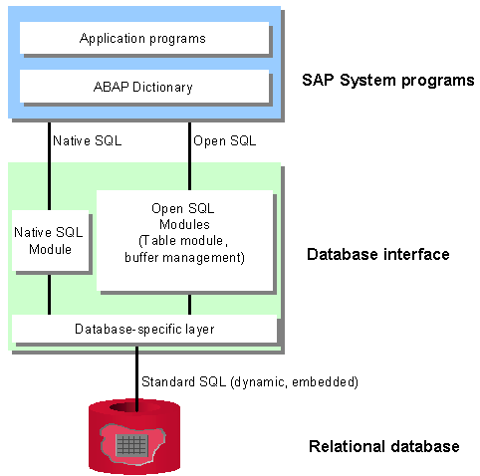
ABAP Basics
Open SQL
ABAP Basics
SQL (Structured Query Language) is a largely standardized language for accessing relational databases. It can be divided into three areas:
· Data Manipulation Language (DML)
Statements for reading and changing data in database tables.
· Data Definition Language (DDL)
Statements for creating and administering database tables.
· Data Control Language (DCL)
Statements for authorization and consistency checks.
Types of Programs
ABAP Editor & Basic Terminology
Data Type & Variables
Internal Tables
Operators
Control Structures: DO..ENDDO
Open SQL: Overview
Modularization Techniques
Messages
Authorization Checks

Slide 41
ABAP Basics
Open SQL
ABAP Basics
Types of Programs
Open SQL consists of a set of ABAP statements that perform operations on the central database
Open SQL statements will work in any SAP system, regardless of the database system in use.
Open SQL statements can only work with database tables that have been created in the ABAP Dictionary
In Open SQL statements, views are handled in exactly the same way as database tables
ABAP Editor & Basic Terminology
Data Type & Variables
Internal Tables
Operators
Control Structures: DO..ENDDO
Open SQL: Overview
Modularization Techniques
Messages
Authorization Checks

Slide 42
ABAP Basics
Open SQL
ABAP Basics
Open SQL Operations
Types of Programs
Keyword | Function
SELECT | Reads data from database tables
INSERT | Adds lines to database tables
UPDATE | Changes the contents of lines of database tables
MODIFY | Inserts lines into database tables or changes the contents of existing lines
DELETE | Deleting Lines from Database Tables
OPEN CURSOR, | Reads lines of database tables using the cursor
FETCH,
CLOSE CURSOR
ABAP Editor & Basic Terminology
Data Type & Variables
Internal Tables
Operators
Control Structures: DO..ENDDO
Open SQL: Overview
Modularization Techniques
Messages
Authorization Checks
Return Codes:
SY-SUBRC to indicate success or failure of Open SQL operation
SY-DBCNT to specify number of database line processed

Slide 43
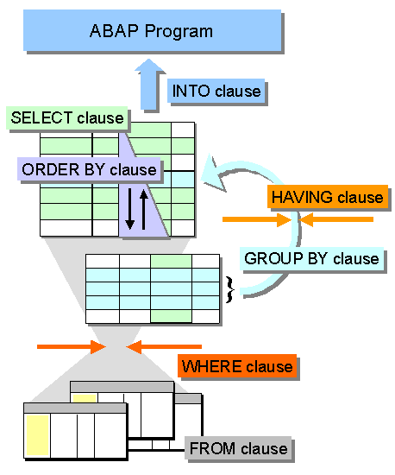
ABAP Basics
Open SQL: Selection
ABAP Basics
SELECT is used to read the data from table.
Single record
Multiple records
Aggregate results
Syntax:
SELECT result INTO target FROM source [WHERE condition] [GROUP BY fields] [HAVING cond] [ORDER BY fields].
Types of Programs
ABAP Editor & Basic Terminology
Data Type & Variables
Internal Tables
Operators
Control Structures: DO..ENDDO
Open SQL: Selection
Modularization Techniques
Messages
Authorization Checks

Slide 44
ABAP Basics
Open SQL: Selection
ABAP Basics
Clause | Description
SELECT result | The SELECT clause result defines the structure of the data you want to read, that is, whether one line or several, which columns you want to read, and whether identical entries are acceptable or not.
INTO target | The INTO clause determines the target area target into which the selected data is to be read.
FROM source | The FROM clause specifies the database table or view the source from which the data is to be selected. It can also be placed before theINTO clause.
WHERE cond | The WHERE clause specifies which lines are to be read by specifying conditions for the selection.
GROUP BY fields | The GROUP-BY clause produces a single line of results from groups of several lines. A group is a set of lines with identical values for each column listed infields.
HAVING cond | The HAVING clause sets logical conditions for the lines combined using GROUP BY.
ORDER BY fields | The ORDER-BY clause defines a sequence fields for the lines resulting from the selection.
Types of Programs
ABAP Editor & Basic Terminology
Data Type & Variables
Internal Tables
Operators
Control Structures: DO..ENDDO
Open SQL: Selection
Modularization Techniques
Messages
Authorization Checks

Slide 45
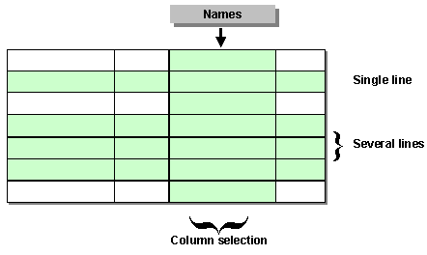
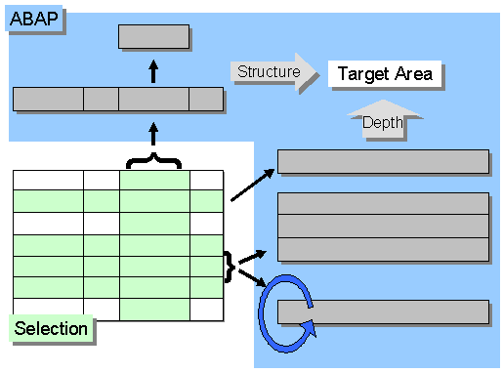
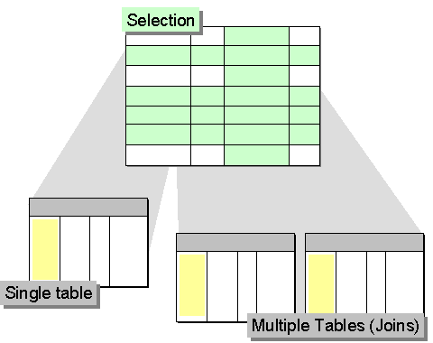
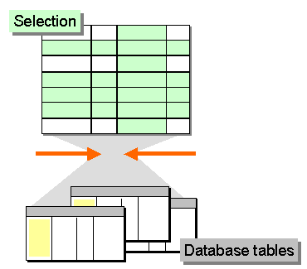
ABAP Basics
Open SQL: Selection
ABAP Basics
Types of Programs
ABAP Editor & Basic Terminology
Columns Names
Data Type & Variables
Target
Internal Tables
Operators
Control Structures: DO..ENDDO
Data Source
Open SQL: Selection
Modularization Techniques
Where Clause
Messages
Authorization Checks

Slide 46
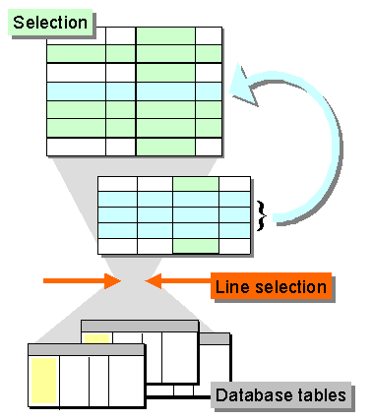
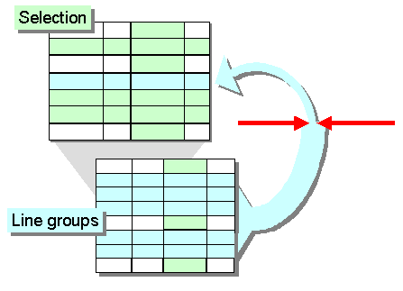
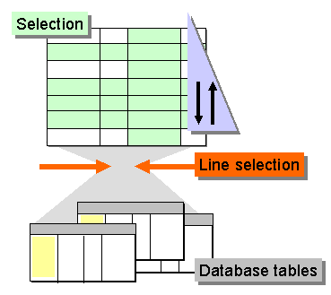
ABAP Basics
Open SQL: Selection
ABAP Basics
Types of Programs
ABAP Editor & Basic Terminology
Grouping Operation
Data Type & Variables
Grouping
Internal Tables
Operators
Control Structures: DO..ENDDO
Open SQL: Selection
Modularization Techniques
Messages
Authorization Checks
Order

Slide 47
ABAP Basics
Open SQL: Selection
Selecting data from single record
Individual columns from table into Individual fields
Data: l_matnr type matnr,
l_mtart type mtart.
Select single MATNR MTART
From mara
Into (L_MATNR,L_MTART)
Where matnr = ‘M1’.
Individual Columns into work area
Data: Begin of wa_mara,
matnr type matnr,
mtart type mtart,
End of wa_mara
Select single matnr mtart
From mara
Into wa_mara
Where matnr = ‘M1’.
All columns from table into work area
Data: wa_mara type mara.
Select single *
From mara
Into wa_mara
Where matnr = ‘M1’.
ABAP Basics
Types of Programs
ABAP Editor & Basic Terminology
Data Type & Variables
Internal Tables
Operators
Control Structures: DO..ENDDO
Open SQL: Single Record
Modularization Techniques
Messages
Authorization Checks

Slide 48
ABAP Basics
Open SQL: Selection
ABAP Basics
Note:
Most of the times, SELECT SINGLE is used for existence checking of record in table.
It is recommended to use primary key in where clause.
MOVE-CORRESPONDING
It will be used when
Order of the fields in the internal table/work area differ from fields in the select clause in the select Query
It is not recommended. Better to declare work area/Internal table in the way in which order you are selecting data from table
It will be worked only when name of the field in the internal table/work area is same as column name in the table
Types of Programs
ABAP Editor & Basic Terminology
Data Type & Variables
Internal Tables
Operators
Control Structures: DO..ENDDO
Open SQL: Single Record
Modularization Techniques
Messages
Authorization Checks

Slide 49
ABAP Basics
Open SQL: Selection
Selecting Multiple Records
ABAP Basics
Types: begin of t_mara, Matnr type matnr, Mtart type mtart, End of t_mara Data: it_mara type table of t_mara Select Matnr Mtart From mara Into table it_mara Where mtart = ‘HALB’. Note: this approach is recommended. Specify columns selecting order same as work area fields order. | Types: begin of t_mara, Matnr type matnr, Mtart type mtart, End of t_mara Data: it_mara type table of t_mara Select * From mara Into corresponding fields of table it_mara Where mtart = ‘HALB’. Note: this approach has performance issues | Data: it_mara type table of mara. Select Mtart Matkl Matnr From mara Into corresponding fields of table it_mara Where mtart = ‘HALB’. Note: this is just for example but not used
Types of Programs
ABAP Editor & Basic Terminology
Data Type & Variables
Internal Tables
Operators
Control Structures: DO..ENDDO
Open SQL: Multiple Records
Modularization Techniques
Messages
Authorization Checks

Slide 50
ABAP Basics
Open SQL: Selection
Selecting Multiple Records
ABAP Basics
Types of Programs
For All Entries Clause: It is used to get the data from table based on entries
In internal table.
Example:
Select *
From MARC
Into Table IT_MARC
For All Entries IT_MARA
Where MATNR = IT_MARA-MATNR
Note: if IT_MARA is initial then above select query will fetch all the
Records from MARC table. It is huge performance issue
Before selecting, Initial check should be added as below
If IT_MARA is Not Initial
“ Select Query
Endif.
ABAP Editor & Basic Terminology
Data Type & Variables
Internal Tables
Operators
Control Structures: DO..ENDDO
Open SQL: Multiple Records
Modularization Techniques
Messages
Authorization Checks

Slide 51
ABAP Basics
Open SQL: Selection
Selecting Multiple Records
ABAP Basics
Types of Programs
Select specific number of Records using UP TO <N> rows
Example:
Select *
UP TO 2 ROWS
From MARC
Into Table IT_MARC
Where MATNR = ‘HALB’
Aggregate Result
Get Data in order
Select *
UP TO 2 ROWS
From MARC
Into Table IT_MARC
Where MATNR = ‘HALB’
Order by MATNR Ascending
ABAP Editor & Basic Terminology
Data Type & Variables
Internal Tables
Operators
Control Structures: DO..ENDDO
Open SQL: Multiple Records
Modularization Techniques
Messages
Authorization Checks

Slide 52
ABAP Basics
Open SQL: Selection
Looping Database Table
ABAP Basics
We can loop database table using SELECT…ENDSELECT.
SELECT result INTO target FROM source [WHERE condition] [GROUP BY fields] [HAVING cond] [ORDER BY fields].
Endselect
Types of Programs
ABAP Editor & Basic Terminology
Data Type & Variables
Internal Tables
Operators
Control Structures: DO..ENDDO
Open SQL: Looping Database Table
Modularization Techniques
Messages
Authorization Checks

Slide 53
ABAP Basics
Open SQL: Insertion
Insert Records into Database table
ABAP Basics
Types of Programs
Inserting Single Record
Syntax:
INSERT INTO <dbtab> VALUES wa. OR
Insert content in the WA to the database table <dbtab>
Example: INSERT INTO mara VALUES wa_mara
INSERT <dbtab> FROM wa OR
It is a short form of above INSERT command
Example: INSERT mara FROM wa_mara
INSERT <dbtab>.
if we declare work area using TABLES statement then we will use
This command
Example: INSERT mara
ABAP Editor & Basic Terminology
Data Type & Variables
Internal Tables
Operators
Control Structures: DO..ENDDO
Open SQL: INSERT
Modularization Techniques
Messages
Authorization Checks

Slide 54
ABAP Basics
Open SQL: Insertion
Insert Records into Database table
ABAP Basics
Types of Programs
Inserting Multiple Records
Syntax:
INSERT target FROM TABLE itab [ACCEPTING DUPLICATE KEYS
Inserting multiple records at a time
Example: INSERT mara FROM TABLE it_mara
Accepting Duplicate Keys:
Generally runtime errors occurred if we try to insert already existing record. To prevent this runtime errors we will use
ACCEPTING DUPLICATE KEYS. Whenever record found with same then database system will ignore this record
ABAP Editor & Basic Terminology
Data Type & Variables
Internal Tables
Operators
Control Structures: DO..ENDDO
Open SQL: INSERT
Modularization Techniques
Messages
Authorization Checks

Slide 55
ABAP Basics
Open SQL: Update
ABAP Basics
Update Records in the Database table
Types of Programs
Changing Lines Column by Column
Syntax:
UPDATE target SET set₁ set₂... [WHERE cond].
Example:
UPDATE mara SET matkl = ‘S’
WHERE matnr = ‘M1’
Overwriting Individual Lines with Work Areas
Syntax:
UPDATE target FROM wa
first update the content in the work area later execute the command
UPDATE dbtab.
first update the content in the work area later execute the command
Overwriting several lines
Syntax:
UPDATE target FROM TABLE itab.
ABAP Editor & Basic Terminology
Data Type & Variables
Internal Tables
Operators
Control Structures: DO..ENDDO
Open SQL: UPDATE
Modularization Techniques
Messages
Authorization Checks

Slide 56
ABAP Basics
Open SQL: Update
ABAP Basics
Delete Records in the Database table
Types of Programs
Deleting records based on Condition
Syntax:
DELETE FROM target WHERE cond
Example:
DELETE FROM mara WHERE matnr = ‘M1’
Deleting record based on work area
Syntax:
DELETE target FROM wa
Example:
DELETE mara FROM wa_mara
Syntax:
DELETE dbtab.
Deleting several line from Table
Syntax:
DELETE target FROM TABLE itab.
ABAP Editor & Basic Terminology
Data Type & Variables
Internal Tables
Operators
Control Structures: DO..ENDDO
Open SQL: UPDATE
Modularization Techniques
Messages
Authorization Checks

Slide 57
ABAP Basics
Open SQL: Modify
ABAP Basics
Modify Records in the Database table
Types of Programs
If the database table contains no line with the same primary key as the line to be inserted
MODIFY = UPDATE or INSERT
Modifying record based on work area
Syntax:
MODIFY target FROM wa
Example:
MODIFY mara FROM wa_mara
Syntax:
MODIFY dbtab.
Modifying several line from Table
Syntax:
MODIFY target FROM TABLE itab.
ABAP Editor & Basic Terminology
Data Type & Variables
Internal Tables
Operators
Control Structures: DO..ENDDO
Open SQL: MODIFY
Modularization Techniques
Messages
Authorization Checks

Slide 58
ABAP Basics
Open SQL: Client Specified
ABAP Basics
Types of Programs
CLIENT SPECIFIED:
By default, Open SQL statements use automatic client handling. Statements that access client-dependent application tables only use the data from the current client.
... CLIENT SPECIFIED ....
directly after the name of the database table. This addition disables the automatic client handling and you can use the field MANDT both in the WHERE clause and in a table work area.
Committing database changes
COMMIT WORK: always concludes a database LUW
ROLLBACK WORK: always undoes all changes back to the start of the database LUW
ABAP Editor & Basic Terminology
Data Type & Variables
Internal Tables
Operators
Control Structures: DO..ENDDO
Open SQL: Others
Modularization Techniques
Messages
Authorization Checks

Slide 59
ABAP Basics
Open SQL: Performance Notes
ABAP Basics
Guidelines:
Keep the Result Set Small:
Using WHERE and HAVING clause
Minimize the Amount of Data Transferred:
Restrict Number of lines
Restrict Number of Columns
Use aggregate functions
Data transfer when changing data lines
Minimize the Number of Data Transfers
Single Operation instead of multiple operations
Avoid repeated access
Avoid nested select loops
Using View instead of Inner join in the select query
Subqueries in WHERE and HAVING clauses
Using internal tables
Using cursors read data
Types of Programs
ABAP Editor & Basic Terminology
Data Type & Variables
Internal Tables
Operators
Control Structures: DO..ENDDO
Open SQL: Others
Modularization Techniques
Messages
Authorization Checks

Slide 60
ABAP Basics
Open SQL: Performance Notes
ABAP Basics
Guidelines:
Minimize the Search Overhead
Database Indexes
Check for equality and link them using AND
Using Positive Conditions
Don’t use OR
Use at least part of index
Don’t check for NULL values
Avoid complex conditions
Reduce the Database Load
Buffer tables on application server: but some clauses in the select query will bypass the buffer access
Avoid data reading repeatedly
Avoid using ORDER BY clause
Types of Programs
ABAP Editor & Basic Terminology
Data Type & Variables
Internal Tables
Operators
Control Structures: DO..ENDDO
Open SQL: Others
Modularization Techniques
Messages
Authorization Checks

Slide 61
ABAP Basics
Open SQL: Cursors
ABAP Basics
Cursors
Decoupling Select Query from database access
Open Cursor
To open a cursor for a SELECT statement, use the following:
OPEN CURSOR [WITH HOLD] c FOR SELECT result FROM source [WHERE condition] [GROUP BY fields] [HAVING cond] [ORDER BY fields].
Read Data
FETCH NEXT CURSOR c INTO target.
Close Cursor
To close a cursor explicitly, use the following statement:
CLOSE CURSOR c.
Types of Programs
ABAP Editor & Basic Terminology
Data Type & Variables
Internal Tables
Operators
Control Structures: DO..ENDDO
Open SQL: Others
Modularization Techniques
Messages
Authorization Checks

Slide 62
ABAP Basics
Modularization Technique
ABAP Basics
We will divide the entire program into smaller blocks and call them whenever
Necessary. This is for readability and reusability
Modularization Techniques:
Subroutines
Function Modules
Includes
Macros
Events
Classes and Methods
Dialog Modules
Types of Programs
ABAP Editor & Basic Terminology
Data Type & Variables
Internal Tables
Operators
Control Structures:
Open SQL
Modularization Techniques
Messages
Authorization Checks

Slide 63
ABAP Basics
Modularization Technique: Subroutines
Subroutines are the callable processing blocks which contains and interface,
Local data area
We can define subroutine using FORM <form_name> ..ENDFORM
Syntax:
Form <sub_routine> Tables <send_and_received_tables>
Using <received_variables>
Changing <send_and_received_variables> .
“Local Data
“Logic
Endform.
We can call subroutine using PERFORM <form_name> statement
Syntax
Perform <sub_routine> Tables <send_and_received_tables>
Using <send_variables>
Changing <send_and_received_variables>
We can call subroutines in the same program as well as from other programs called external subroutines
Syntax:
Perform <sub_routine> <parameters> IN PROGRAM <program Name>
We can exit the subroutine processing using EXIT statement
ABAP Basics
Types of Programs
ABAP Editor & Basic Terminology
Data Type & Variables
Internal Tables
Operators
Control Structures:
Open SQL
Modularization Techniques:
Subroutines
Messages
Authorization Checks

Slide 64
ABAP Basics
Modularization Technique: Subroutines
Types of Parameters
Actual Parameters
Values which provided from main program while calling subroutine
Formal Parameters
Values which available at subroutine at definition of subroutine
Parameter Passing Mechanism
Pass by value – actual parameter retains its own value.
Pass by reference – actual parameters value can be changed
Pass by value/reference – actual parameter only changed when complete execution of subroutine
Notes:
Variable, which declared in main program, will be automatically available in all subroutines, which are defined in the program. Passing data to subroutine is optional. But for the clarity we need to do it.
By default, subroutines adopt pass by reference mechanism. So that; whatever the changes made for the variables inside the subroutine, will be affected in main program (calling program)
ABAP Basics
Types of Programs
ABAP Editor & Basic Terminology
Data Type & Variables
Internal Tables
Operators
Control Structures:
Open SQL
Modularization Techniques:
Subroutines
Messages
Authorization Checks

Slide 65
ABAP Basics
Modularization Technique: Function Modules
ABAP Basics
Function modules are the callable processing blocks which contains and interface,
Local data area. Function modules are defined in function groups.
Function modules are external processing blocks and which are Available to the entire SAP system. They are managed in function library
Function group has the following
TOP include for global data
Function Modules
Whenever creating function group, automatically one global program will be created with naming convention ‘SAPL<function group name>’
Types of Programs
ABAP Editor & Basic Terminology
Data Type & Variables
Internal Tables
Operators
Control Structures:
Open SQL
Modularization Techniques:
Function Module
Messages
Authorization Checks

Slide 66
ABAP Basics
Modularization Technique: Function Modules
ABAP Basics
Transaction code: SE37/SE80
Calling function Modules
To call a function module, use the CALLFUNCTION statement:
Syntax:
CALL FUNCTION module [EXPORTING f₁ = a₁... f_{n} = a_{n}] [IMPORTING f₁ = a₁... f_{n} = a_{n}] [CHANGING f₁ = a₁... f_{n} = a_{n}] [TABLES f₁ = a₁ ... f_{n} = a_{n}] [EXCEPTIONS e₁ = r₁ ... e_{n} = r_{n} [ERROR_MESSAGE = r_{E}] [OTHERS = r_{o}]].
Types of Programs
ABAP Editor & Basic Terminology
Data Type & Variables
Internal Tables
Operators
Control Structures:
Open SQL
Modularization Techniques:
Function Module
Messages
Authorization Checks

Slide 67
ABAP Basics
Modularization Technique: Includes
ABAP Basics
Includes are source code modules and are global R/3 Repository objects. Include program non executable programs
They are solely for modularizing source code, and have no parameter interface
Library:
Include programs allow you to use the same source code in different programs. For example, this can be useful if you have lengthy data declarations that you want to use in different programs.
Order.
Include programs allow you to manage complex programs in an orderly way
Program Type: I
Include the program in the other program using INCLUDE <incl_name>
Restrictions:
Include programs cannot call themselves.
Include programs must contain complete statements.
Types of Programs
ABAP Editor & Basic Terminology
Data Type & Variables
Internal Tables
Operators
Control Structures:
Open SQL
Modularization Techniques:
Includes
Messages
Authorization Checks

Slide 68
ABAP Basics
Modularization Technique: Macro
ABAP Basics
If you want to reuse the same set of statements more than once in a program, you can include them in a macro
Defining Macro
Syntax:
DEFINE makro.
statements
END-OF-DEFINITION
Calling Macro
Syntax
makro [p1 p2... p9].
Types of Programs
ABAP Editor & Basic Terminology
Data Type & Variables
Internal Tables
Operators
Control Structures:
Open SQL
Modularization Techniques:
Macro
Messages
Authorization Checks

Slide 69
ABAP Basics
Debugging
ABAP Basics
The ABAP debugger is a tool of the with which you can stop running program
And then execute them line by line or section by section
The ABAP Debugger is an integrated test tool within the ABAP workbench
Invoke Debugger
/H command OR
Break points source code
Hard Coded break points – BREAK-POINT
Session Break Points
External Break Points/User Break Points
Function Keys used in Debugging
F5 - Step By Step Execution
F6 – Single Step Execution of Processing Block
F7 – Coming out from current Processing Block
F8 – Complete execution or Jump to next Break point
Types of Programs
ABAP Editor & Basic Terminology
Data Type & Variables
Internal Tables
Operators
Control Structures:
Open SQL
Modularization Techniques
Debugging
Authorization Checks

Slide 70
ABAP Basics
Debugging
ABAP Basics
Some features of New ABAP Debugger
Tools in ABAP Debugger
Source Code view
Data: Overview of variables, Table, Structures, Objects
Break Points/Watch Points
Stack
Screen Analysis
Diff Tool
Functions:
System Debugging
External Debugging
Types of Programs
ABAP Editor & Basic Terminology
Data Type & Variables
Internal Tables
Operators
Control Structures:
Open SQL
Modularization Techniques
Debugging
Authorization Checks

Slide 71
ABAP Basics
Messages
ABAP Basics
Messages are used to issues messages using ABAP statement MESSAGE
There are several ways to issue messages
Issue message directly
MESSAGE <msg_text> TYPE <msg_type>
Type indicates the severity of the situation in the program. Based on the message type, subsequent processing of the program depends
Message Types:
X – Exit – Program will end with runtime error
A – Abend/Termination- Program will be ended by displaying a pop up message
E – Error - Program processing will be stopped until we clear/correct the data. Depends on the program context
W – Warning – Program temporarily halt but will be continued when pressing enter. Depends on the program context
I – Information – Popup will be displayed. Once press enter, program execution continues
S – Success/Status – Message issued but program execution still continues
Types of Programs
ABAP Editor & Basic Terminology
Data Type & Variables
Internal Tables
Operators
Control Structures:
Open SQL
Modularization Techniques
Messages
Authorization Checks

Slide 72
ABAP Basics
Messages
ABAP Basics
Maintain Messages Globally
We can maintain messages in the message class and same can use in the programs
Messages will be maintained in Message class with some number
Transaction: SE91
Issue message with help of Message class and message number
Syntax:
MESSAGE <Type><Number>(<Message_Class>)
The above statement will fetch text from message class and will be displayed
Dynamic text for message text instead from Message Class
Syntax
MESSAGE <Type><Number>(<Message_Class>)
WITH ‘<text>’ ‘<text>’ ‘<text>’ ‘<text>’
Types of Programs
ABAP Editor & Basic Terminology
Data Type & Variables
Internal Tables
Operators
Control Structures:
Open SQL
Modularization Techniques
Messages
Authorization Checks

Slide 73
ABAP Basics
Authorization Checks
ABAP Basics
Authorization check is for controlling program access.
Steps to add authorization check to programs
Create Authorization field
Create Authorization Object
Program Authorization Check
Use the ABAP AUTHORITY-CHECK statement.
Transactions:
SU20 – Authorization Field
SU21 – Authorization Object
SE38 – Authorization Check in the Program
User Roles Maintenance:
PFCG – Assign Authorization Object and associated values to the object
Types of Programs
ABAP Editor & Basic Terminology
Data Type & Variables
Internal Tables
Operators
Control Structures:
Open SQL
Modularization Techniques
Messages
Authorization Checks

Slide 74
ABAP Basics
Authorization Checks
ABAP Basics
How it will works
User Profile
All authorization data maintained here
Authorization Object and Allowed values
WERKS : 1000, 2000 etc
Types of Programs
Authorization Object
Ex: S_PLANT
Field: WERKS
ABAP Editor & Basic Terminology
Data Type & Variables
Internal Tables
Operators
Program: Logic
AUTHORITY-CHECK OBJECT 'S_PLANT'
ID 'ACTVT' FIELD '02'
ID ‘WERKS' FIELD 'B'.
Control Structures:
Open SQL
Modularization Techniques
Authorization check similar to Select
Query for checking existence of record in the database table
Messages
Authorization Checks

Slide 75
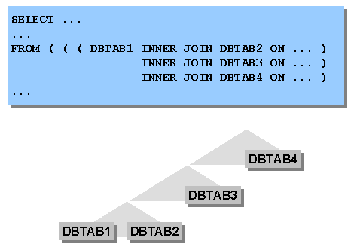
ABAP Basics
Open SQL: Selection
Inner Join
ABAP Basics
We can fetch data from multiple tables with joins by specifying JOIN condition
Syntax
SELECT ... ... FROM tab [INNER] JOIN dbtab [AS alias] ON cond options
Types of Programs
ABAP Editor & Basic Terminology
Data Type & Variables
Internal Tables
Operators
Control Structures: DO..ENDDO
Open SQL: Looping Database Table
Modularization Techniques
Messages
Authorization Checks

Slide 76
ABAP Basics
Open SQL: Selection
ABAP Basics
Table: TAB1
Table: TAB2
Types of Programs
MATNR | MTART | MEINS
M1 | ROH | EA
M2 | ROH | EA
M3 | HALB | EA
M4 | HALB | EA
M5 | FERT | EA
MATNR | WERKS | EKGRP
M1 | P1 | E1
M1 | P2 | E1
M1 | P3 | E1
M2 | P1 | E1
M2 | P2 | E1
M3 | P1 | E1
M3 | P2 | E1
ABAP Editor & Basic Terminology
Data Type & Variables
Internal Tables
Operators
Inner join: TAB1 and TAB2
Join Condition: TAB1-MATNR = TAB2-MATNR
Result set as below
Control Structures: DO..ENDDO
Open SQL: Looping Database Table
MATNR | MTART | MEINS | WERKS | EKGRP
M1 | ROH | EA | P1 | E1
M1 | ROH | EA | P2 | E1
M1 | ROH | EA | P3 | E1
M2 | ROH | EA | P1 | E1
M2 | ROH | EA | P2 | E1
M3 | HALB | EA | P1 | E1
M3 | HALB | EA | P2 | E1
Modularization Techniques
Messages
Authorization Checks

Slide 77
ABAP Basics
Open SQL: Selection
ABAP Basics
Table: TAB1
Table: TAB2
Types of Programs
MATNR | MTART | MEINS
M1 | ROH | EA
M2 | ROH | EA
M3 | HALB | EA
M4 | HALB | EA
M5 | FERT | EA
MATNR | WERKS | EKGRP
M1 | P1 | E1
M1 | P2 | E1
M1 | P3 | E1
M2 | P1 | E1
M2 | P2 | E1
M3 | P1 | E1
M3 | P2 | E1
ABAP Editor & Basic Terminology
Data Type & Variables
Internal Tables
Operators
Left Outer join: TAB1 and TAB2
Join Condition: TAB1-MATNR = TAB2-MATNR
Result set as below
Control Structures: DO..ENDDO
Open SQL: Looping Database Table
MATNR | MTART | MEINS | WERKS | EKGRP
M1 | ROH | EA | P1 | E1
M1 | ROH | EA | P2 | E1
M1 | ROH | EA | P3 | E1
M2 | ROH | EA | P1 | E1
M2 | ROH | EA | P2 | E1
M3 | HALB | EA | P1 | E1
M3 | HALB | EA | P2 | E1
M4 | HALB | EA
M5 | FERT | EA
Modularization Techniques
Messages
Authorization Checks

